Slide 1
MEC 402 Casting, Welding and Forming
Dr. Arjyajyoti Goswami
arjyajyoti.Goswami@me.nitdgp.ac.in
+91-9953167384

Slide 2
Resistance Welding:
What is the principle behind it
SPOT WELDING
Electrodes for Resistance Welding
Heat Distribution in Resistance Spot Welding
Heat balance in Resistance Welding
Shunting in Resistance Welding
Seam Welding, Projection Welding, Flash Butt Welding, Upset Welding

Slide 3
Why study about it
To understand the different salient features Resistance Welding.

Slide 4
Resistance Welding
It is a type of permanent joining technique in which localized coalescence is achieved between two metallic workpieces, with the aid of heat generated from the resistance to the flow of current ,with the use of pressure and without the use of filler.
Mostly used for joining of sheets.
Less heat is involved in this process as compared to Arc Welding, therefore the Heat Affected Zone, thermal distortion, damages etc. are much lesser as.
The magnitude of heat generated is proportional to the current that is flowing and the resistance encountered by the current during its flow and the duration of flow of current.

Slide 5
Front View
Side View

Slide 6
Process of the Resistance Welding
Put the plates (sheets) in required configuration.
Place the electrodes in contact with the workpiece by pressing a lever. This engages the electrodes and also imparts a pre determined pressure to the plates.
Switch on the power supply so that the current starts flowing through the plates. This flow of current will be generating the resistance heating.
This is to be continued till the plates have been elevated to higher temperature such that the interface has melted (the duration of current flow is governed by the thickness of the plates, material of the plates and the level of current being used).
Then the lever is pressed further down such that a larger pressure is applied on the workpieces and the fusion in achieved.

Slide 7
Wherever fusion takes place a WELD NUGGET is formed.
The diameter of the weld nugget corresponds to the diameter of the electrodes. In case the diameters of the electrodes are different, the diameter of the nugget will correspond to the smaller diameter electrode.

Slide 8
Pressure during the SPOT WELDING
Resistance Spot Welding is aided by pressure. Initialy the pressure is just for engaging the electrodes. After the current has flown for a cetain duration a larger pressure is applied.
The larger pressure must be applied only after the fusion temperature has been reached.
The pressure may be applied through hydraulic press, pneumatic press or through mechanical means. Most ferrous metal are spot welded at constant pressure.
For self-thinking : Will application of variable pressure yield better result ? How the pressure should be varied during its application ?

Slide 9
Electrode for Resistance Welding
Types of electrode heads used in spot welding
Should be able to carry high amounts of current that is needed for the resistance welding.
Should be able to withstand high mechanical loads that will be needed for the proper fusion of the workpieces.
Should have high electrical conductivity, thermal conductivity and high hardness.
Pointed
Dome
Flat
Truncated
Normally Copper is preferred as the electrode material but to enhance its properties (mostly hardness) Cu-Cd (1-5%) and Cu-Cr (0.5-0.8%) is also used.
Cu –Cd : for Al and Mg, Cu-Cr – for MS and low Alloy steel.

Slide 10
Composite resistance
For resistance welding, Q = I^2*R*t, R is the composite resistance made up of (on both sides)
R1 : Resistance offered by the electrode to the flow of the current
R2 : Resistance at the interface between the electrode tip and the workpiece
R3 : Resistance offered by the workpiece to the flow of current
R4 : Resistance at the interface between the two workpieces
R4 must be maximized while the other resistances must be minimized as they do not contribute to the welding rather results in losses.

Slide 11
Resistance at the interface, R2 and R4, is also called as Contact Resistance.
Contact Resistance is affected by the surface finish on the plates. Rougher plates have higher contact resistance.
Contact resistance is also affected by the cleanliness of the surface.
Dirtier interface results in higher composite resistance.

Slide 12
Heat distribution in Resistance Welding
Distance from centerline
Temperature

Slide 13
Heat distribution in Resistance Welding
Distance from centerline
Temperature

Slide 14
Heat Balance in Resistance Welding
In most cases of Resistance Spot Welding the sheet materials, thickness of the sheets, and the electrode material are same – this lends an inherent symmetry to the heat generated in the welding and the weld nugget is symmetrical.
If the heat is not balanced it will result in unsymmetrical weld nugget.
Qu = Ql
Qu > Ql
Qu < Ql

Slide 15
Reasons for Heat Imbalance in Resistance Welding
Dissimilar thickness of sheets : Sheets having more thickness will generate more heat.
Dissimilar material of the sheets : Sheets having more resistivity will generate more heat.
Due to heat imbalance the weld nugget tends to shift towards the side where more heat is being generated.
Both “p” and “l” are contributing to the heat imbalance, but manipulating “a” can solve this problem.

Slide 16
Solutions for Heat Imbalance in Resistance Welding
Increasing resistivity of the electrode tip: The resistivity of the electrode tip can be used on the side where more heat is needed.
Reducing the diameter of the electrode: The diameter of the electrode can be reduced on the side where more heat is needed. This increases the resistivity of the electrode tip on that side (by reducing the area “a”)

Slide 17
4 cases of Resistance Spot Welding and ways to achieve heat balance

Slide 18
Case 1 : Sheets of same material but different thickness
Qu > Ql
Thicker sheet will have more resistance hence more heat will be generated on that side so the weld nugget will tend to shift towards that side.

Slide 19
Solution 1
Use electrode with lower diameter on the side where more heat is needed (lower side for this case).
Sometimes because of design constraints we may not be able to accept the lower weld nugget size (because the size of the weld nugget will be equal to the lower diameter electrode).

Slide 20
Solution 2
Use electrode tip with higher resistivity on the side where more heat is needed (lower side for this case).
No need to tinker with the diameter of the electrode.
Red color is symbolizing greater resistivity.

Slide 21
Case 2 : Sheets of different material but same thickness
Qu > Ql
Sheet with high resistivity will generate more heat so the weld nugget will tend to shift towards that side.

Slide 22
Solution 1
Use electrode tip with higher resistivity on the side where more heat is needed (lower side for this case).
No need to tinker with the diameter of the electrode.

Slide 23
Solution 2
Use electrode with lower diameter on the side where more heat is needed (lower side for this case).
Can be used only when dimension of a weld nugget is not an issue.

Slide 24
Case 3 : Thinner sheet with higher resistivity
Qu = Ql
In such a case, it is possible that heat is inherently balanced. If not, then we may have to use the solutions mentioned previously. But there is a strong possibility that the heat will be inherently balanced.

Slide 25
Case 4 : Thinner sheet with lower resistivity
This is the worst case of heat imbalance. So more than one solutions may have to be applied to achieve heat balance.

Slide 26
Shunting in Spot Resistance Welding
Because of shunting the spots of welding must be separated from each other by a minimum distance called as Weld Spot Spacing.
The weld spot spacing depends on – amount of current being used, conductivity of the sheets being welded, nature of the already welded joint.

Slide 27
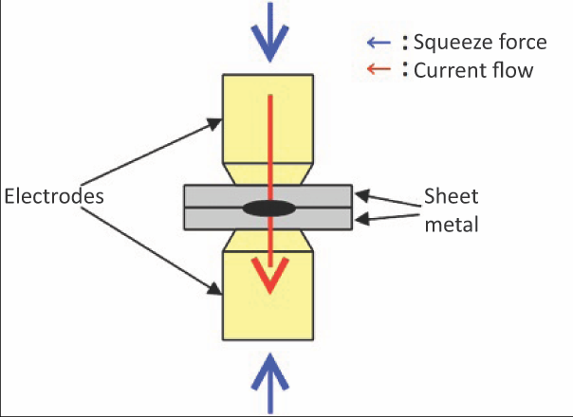
Spot Welding
https://www.hioki.com/en/products/introduction/detail/?dbid=113447

Slide 28
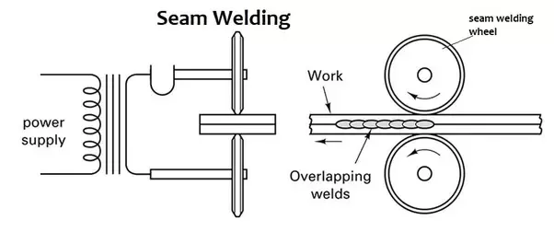
https://www.quora.com/What-is-seam-welding

Slide 29
Flash Butt Welding

Slide 30
Upset Welding

